Slide 1
Homework Intuitions
Logistic Regression with a NN mindset
Problem Statement:
You are given a dataset (”data.h5”) containing:
• a training set of m_train images labeled as cat (y=1) or non-cat (y=0) • a test set of m_test images labeled as cat or non-cat • each image is of shape (num_px, num_px, 3) where 3 is for the 3 channels (RGB).
Thus, each image is square (height = num_px) and (width = num_px)
You will build a simple image-recognition algorithm that can correctly classify pictures as cat or non-cat

Slide 2
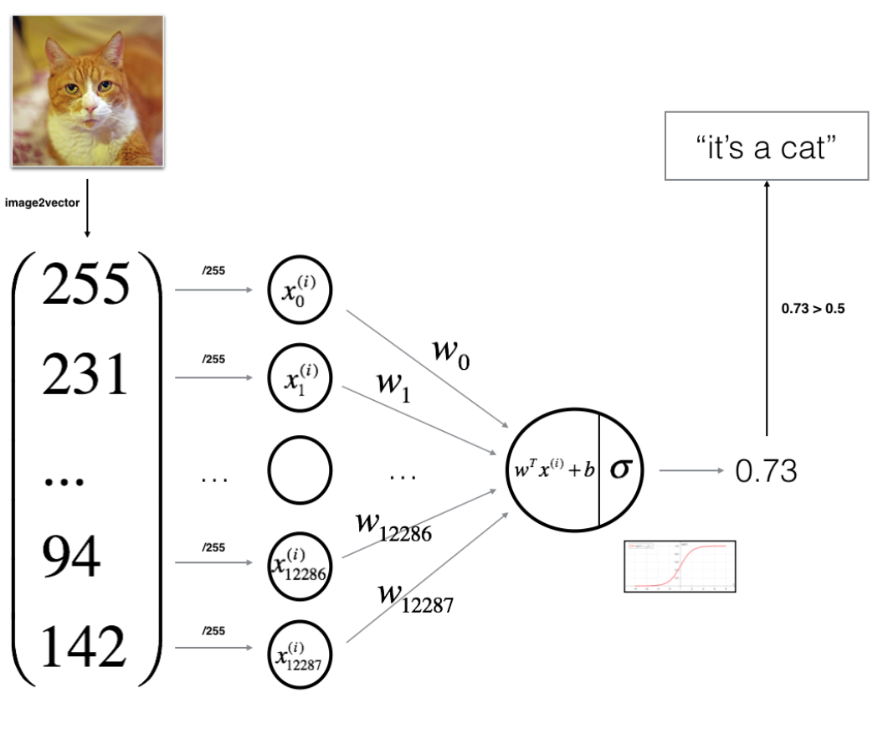
Homework Intuitions
Logistic Regression with a NN mindset

Slide 3
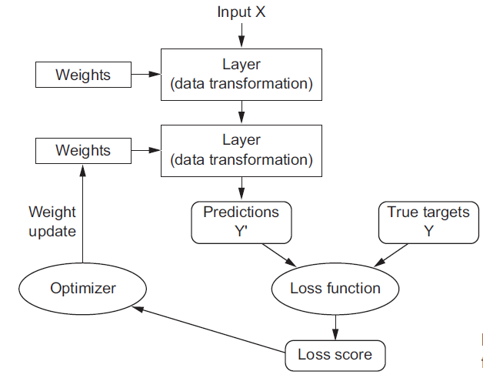
Homework Intuitions
Logistic Regression with a NN mindset

Slide 4
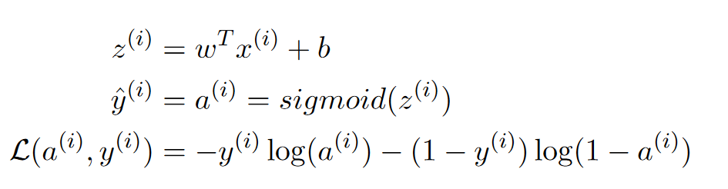
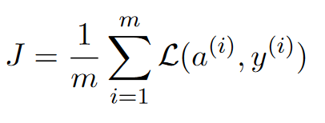
Homework Intuitions
Logistic Regression with a NN mindset
Mathematical expression of the algorithm:
For one example x^{(i)}
The cost is then computed by summing over all training examples:

Slide 5
Homework Intuitions
Logistic Regression with a NN mindset
Key steps:
In this exercise, you will carry out the following steps:
• Initialize the parameters of the model
• Learn the parameters for the model by minimizing the cost
• Use the learned parameters to make predictions (on the test set)
• Analyse the results and conclude

Slide 6
Homework Intuitions
Logistic Regression with a NN mindset
Building the parts of our algorithm
The main steps for building a Neural Network are: • Define the model structure (such as number of input features) • Initialize the model’s parameters
• Loop: – Calculate current loss (forward propagation) – Calculate current gradient (backward propagation) – Update parameters (gradient descent)

Slide 7
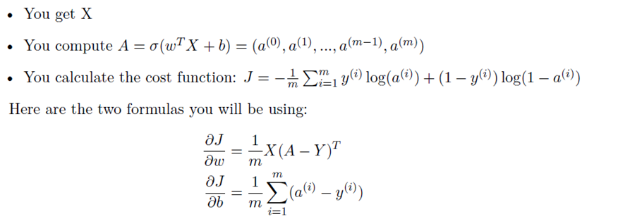
Homework Intuitions
Logistic Regression with a NN mindset
Forward and Backward propagation
Now that your parameters are initialized, you can do the ”forward” and ”backward”
propagation steps for learning the parameters.
Exercise: Implement a function propagate() that computes the cost function and its gradient.
Hints: Forward Propagation:

Slide 8
Homework Intuitions
Logistic Regression with a NN mindset
Optimization
• You have initialized your parameters.
You are also able to compute a cost function and its gradient.
• Now, you want to update the parameters using gradient descent.
Exercise: Write down the optimization function. The goal is to learn w and b by minimizing the cost function J. For a parameter , the update rule is
Ɵ= Ɵ – α dƟ, where is the learning rate.

Slide 9

Homework Intuitions
Logistic Regression with a NN mindset
Exercise: The previous function will output the learned w and b. We are able to use w and b to predict the labels for a dataset X.
Implement the predict() function.
There is two steps to computing predictions:
Calculate
Convert the entries of a into 0 (if activation <= 0.5) or 1 (if activation > 0.5), stores the predictions in a vector ‘Y_prediction’.

Slide 10
Homework Intuitions
Logistic Regression with a NN mindset
Merge all functions into a model
You will now see how the overall model is structured by putting together all the building blocks (functions implemented in the previous parts) together, in the right order.
Exercise: Implement the model function. Use the following notation:
• Y_prediction for your predictions on the test set
• Y_prediction_train for your predictions on the train set
• w, costs, grads for the outputs of optimize()

